Slide 1
Introduction to IOT
G.Mallikarjuna Rao

Slide 2
Syllabus
Unit III
Introduction To Internet of Things: Introduction, Physical Design of IoT, Logical Design of IoT, IoT enabling Technologies, IoT Levels and Deployment Templates
Domain Specific IoTs: Introduction, Home Automation, Smart Cities, Environment, Energy, Retail, Logistics, Agriculture, Industry, Health and LifeStyle
UNIT IV
IoT Systems- Logical Design Using Python: Introduction, Installing python, Python data types and data structures, Control Flow, Functions, Modules, Packages, File Handling, Date/ Time operations, Classes, Python Packages of Interest for IoT.
IoT Physical Devices And End Points: IoT Device, Exemplary Device: Raspberry Pi, About the board, Linux on Raspberry Pi, Raspberry Pi Interfaces, Programming Raspberry Pi with Python

Slide 3
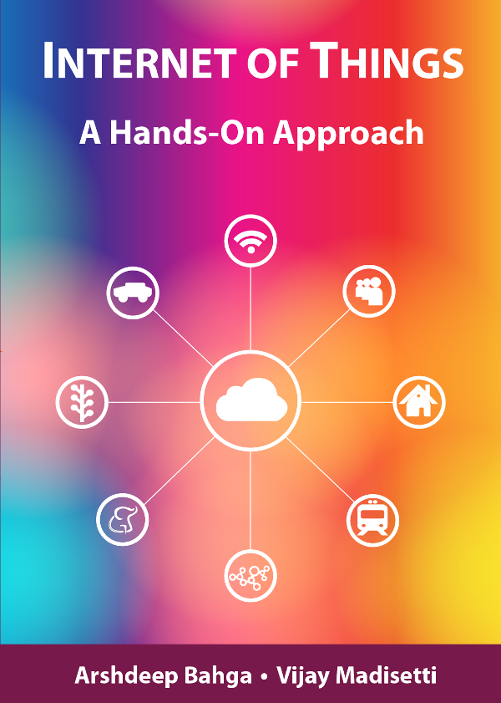
Chapter 1
Introduction to IoT
Book website: http://www.internet-of-things-book.com
Bahga & Madisetti, © 2015

Slide 4
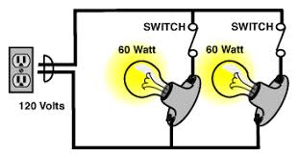
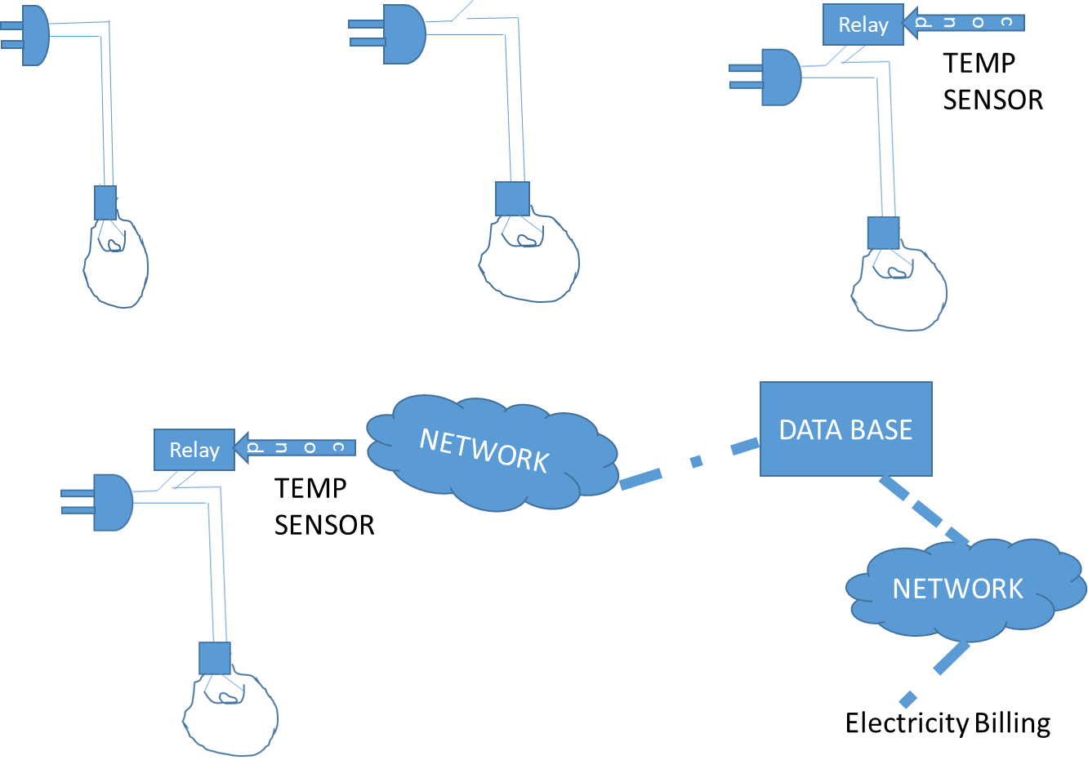
INSIGHT
Notes:
Here is the flow. Bulb without control, Bulb with human control, Bulb with autonomous(self) control and final frame work with using IOT

Slide 5
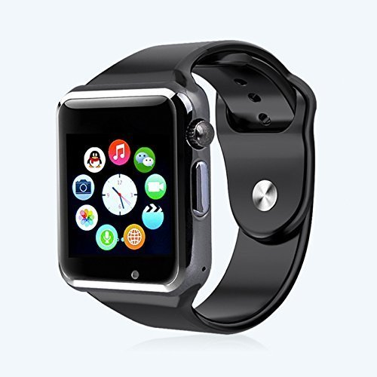
INSIGHT
SMART WATCH
Internet Provision
Sensors
GPS Supported
Accelerometer sensor Gyroscope sensor Geomagnetic sensor Optical heart rate sensor Ambient light sensor Air pressure sensor Capacitive sensor
Video Call Management
Mailing Provision
Contact List Storage
Notes:
Watch is normally meant for time indication however, smart watch will perform several autonomous activities using its sensors. We can treat as shadow companion of human.

Slide 6
Contents
Definition of IOT
How It Works
Technologies - Protocols
Applications of IOT
Notes:
We focus definition of Internet of things and how is work , what are the technologies and protocols involved. Finally we see the applications.

Slide 7
IOT Definition
IOT is the collection of devices (that gather the information) sensors, communication protocols ( D-D communication) and Internet aimed for providing better experience and comfort to human.
IoT is a network of physical objects which embedded with software, electronics, sensors and connectivity to enable it to achieve greater value and services by exchanging data with the manufacturer, operator or connected with other devices
Notes:
IOT has many definitions we can treat it as collection of devices, sensors, communication protocols and internet aimed for providing better quality of life

Slide 8
How it Works
The devices gather the information about the environment of the application domain using sensors.
Exchange the gathered information through the associated networks using appropriate protocols.
Use data analytics for taking appropriate decision.
Implement actions using actuators ( controllers, devices, sensors and control programs).
P

Slide 9
Technologies -Protocols
Technologies
NFC and RFID
Low-Energy Bluetooth
Low-Energy Wireless
Protocols
Radio protocols: ZigBee, Z-Wave
LTE : LTE A
WiFi-Direct : P2P communication
Notes:
IOT uses wireless technologies such as Radio frequency Identifiers, Blue tooth and protocols ZigBee, Long Term Evaluation (LTE) and peer to peer protocols

Slide 10
Applications
Medical Systems– There are several IoT medical devices, able to keep record of remote health monitoring, blood pressure, heart rate, sugar and major changes in your body.
Transportation – IoT enables smart parking, smart traffic control, electronic toll collection systems, vehicle control, logistic management and road safety assistance.
Environmental Monitoring – Used for more accurate information of air quality, water quality, soil conditions and atmospheric changes. IoT devices in this application typically span a large geographic area and can also be mobile.
Notes:
IOT Application cover wider spectrum of applications ranging from Medical, Transportation, Environmental Monitoring. Manufacturing and Energy Management

Slide 11
Applications
Manufacturing – IoT enable rapid manufacturing of new products, real-time optimization of product manufacturing, dynamic response of product demand.
Energy Management – With the help of IoT electronic appliances you can save energy and reduce energy consumption in your home or office.
Infrastructure Management – Big projects of urban and rural infrastructures like highways, bridges, railway tracks IoT can play an important role.
Summary
P
Notes:
IOT in infrastructure Management plays significant role in national building activities

Slide 12
Chapter 1
Introduction to IoT
Book website: http://www.internet-of-things-book.com
Bahga & Madisetti, © 2015

Slide 13
Characteristics
Dynamic & Self-Adapting
Self-Configuring
Interoperable Communication Protocols
Unique Identity
Integrated into Information Network

Slide 14
Dynamic & Self Adapting: IoT devices and systems may have the capability to dynamically adapt with the changing contexts and take actions based on their operating conditions, user‘s context or sensed environment. Eg: the surveillance system is adapting itself based on context and changing conditions.
2) Self Configuring: allowing a large number of devices to work together to provide certain functionality.
3) Inter Operable Communication Protocols: support a number of interoperable communication protocols and can communicate with other devices and also with infrastructure.
4) Unique Identity: Each IoT device has a unique identity and a unique identifier(IP address).
5) Integrated into Information Network: that allow them to communicate and exchange data with other devices and systems.

